Slide 1
Group 3
4th Weekly Presentation
William Bouchard
Yanis Jallouli
Andy Li
Trevor Tabah
Ben Weiss
Seyed Yazdan Zinati

Slide 2
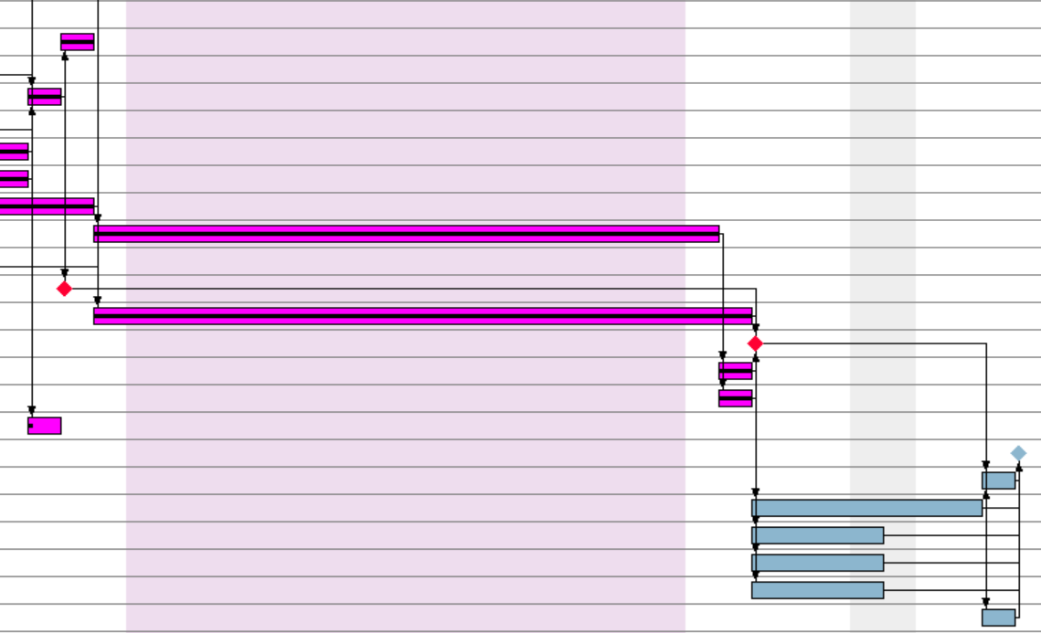
Current Project Status General
To the right you will see our new Gantt chart
Next week consists of 4 main activities
  A more detailed API/commenting of finished code and what needs to be done so future teams can continue where we left off
  More touch ups on test plan now that other people need to understand and do tests
  A Gantt chart + time estimation for future team starting where we left off
  Final document, preparation for submission

Slide 3
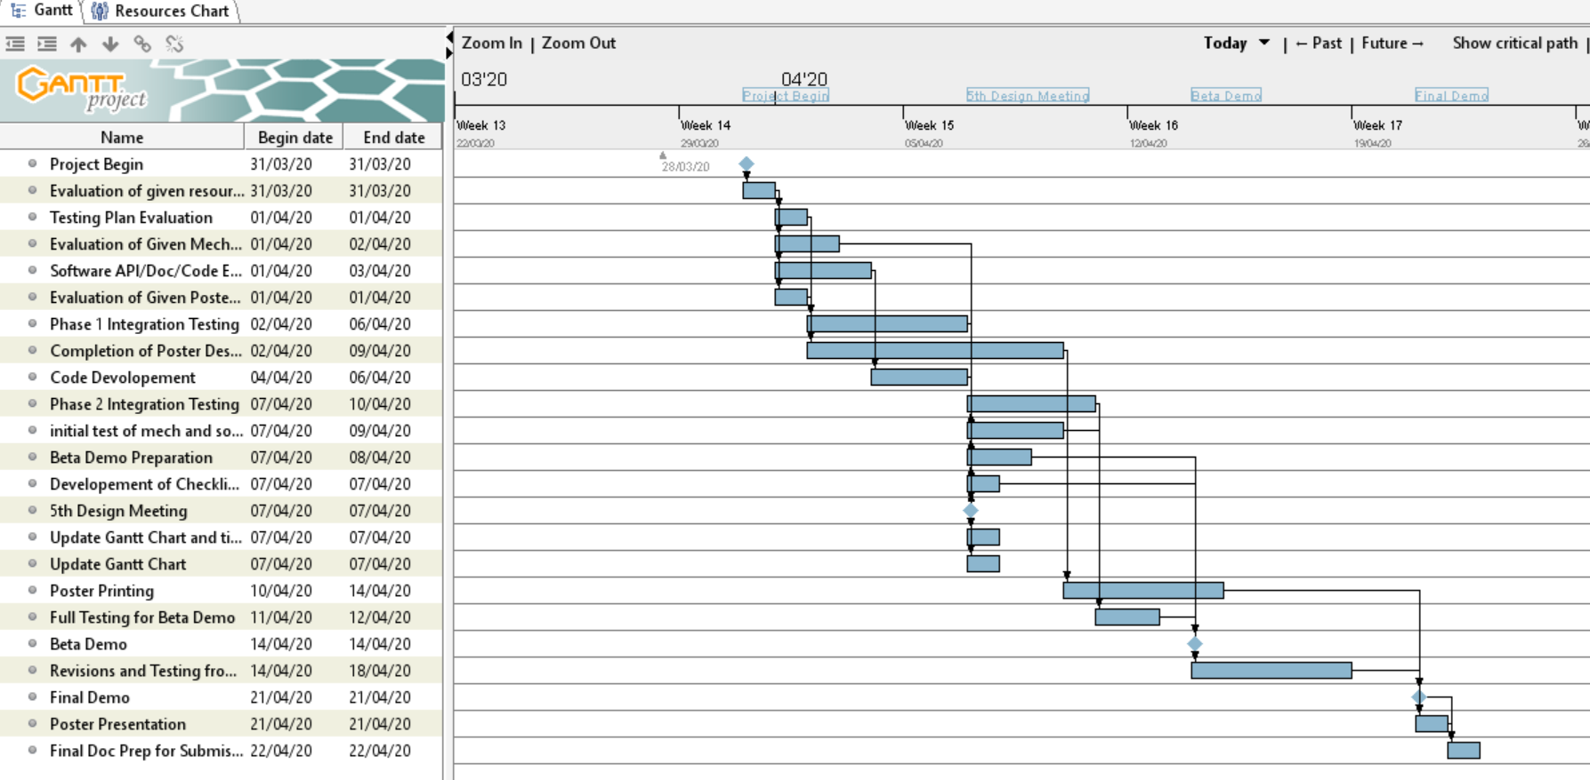
Gantt Chart for Future Teams
Gantt Chart future teams can use and edit to start where we left off and complete the project as planned
Still to do -> time estimation of how long this should take

Slide 4
Budget
Hours from this week are smaller than usual since it has really been only 3 working days since last meeting
Next week will take about 9 hours per person to complete everything for future group
Went through gantt chart and ensured time allocation was consistent with what's in the time sheet
Need to estimate how much time future team would need to complete the project full

Slide 5
Software State
Done :
Localization
Navigation to the tunnel
Navigation through the tunnel
Future :
Island search
Obstacle avoidance
Car retrieval
We now have updated flowcharts
Brief explanations of our ideas for next engineers

Slide 6
Hardware State
Done this week:
  Added feature : Obstacle detection and avoidance for objects facing the robot (V 1.1).
  An updated hardware model was created
  An instruction document on opening hardware models was created
Objectives met:
  Localization :
  Navigation
  Search and Rescue
  Obstacle detection
Future plans :
Minor improvements to be done based on future test results
Improving the overall stability of the robot

Slide 7
Testing State
Documents (with procedures) made for all tests
  Test Plan updated to reflect that the project was cancelled
Templates to fill with data created for tests needed by March 14
  Data collection was left for the weekend due to unavailabilities
Overall - specification of what was planned for each test

Slide 8
Questions?

